Slide 1
Stack overflow annual survey mining
Members: Li Jung Chen, Che Yu Lin, Badon Delmotte

Slide 2
Motivation
Provide information for students that want to join computer science or people that want to switch their career into programmer or CS related jobs. To help them understand what they can be looking into, and what outcome they can expect.
Output: 1. How many professional programer graduate from computer science background. ( CSBG/noneCSBG ratio).
2. The most IDE used by developers.
3. The ranking of used programing language.
4. Average developers salary in different country.
5. Average salary in different educating level in USA.

Slide 3
Introduction to the dataset
Dataset overview: https://insights.stackoverflow.com/survey/2017
Link: Link to download.
The columns to be used: Professional, Major, IDE, HaveWorkedLanguage, Country, Salary, EducationLevel
Notice that Salary are all converted to US dollars for comparison

Slide 4
Design
Our design goal is to utilize AWS’s scalability + Hadoop parallelism to help parallel the process of
-> Extract useful data from csv file ( parse line by line data)
-> Aggregate collected data (group by country, education level, background)
-> Calculate actual result (avg value)
The combination of AWS and Hadoop allows us evaluate in different input_size/machine can vary with the same mapreduce program.

Slide 5
1. How many professional programer graduate from computer science background. ( CSBG/noneCSBG ratio).
We first use map to read the input dataset one line at a time, get the value of Professional column, if it is “Professional developer”, we write it to context and also write the corresponding major.
In reduce phase, get the number of all Professional developers whose majors are CS related(Computer science or software engineering, Computer programming or Web development, Computer engineering or electrical/electronics engineering, Information technology, networking, or system administration) and divided by the number of all Professional developers.

Slide 6
2. The most IDE used by developers.
We first use map to read the input dataset one line at a time, get the value of IDE column, we seperate the value by ”;” to get the specific IDE name(a respondent might have multiple frequently used IDEs, which are recorded in the IDE column and seperated by “;” ), and then write these IDE names to context.
In reduce phase, we get the number of users of each IDE and sort them by their values

Slide 7
3. The ranking of used programing language.
We first use map to read the input dataset one line at a time, get the value of Language column, we seperate the value by ”;” to get the specific Language name(a respondent might have multiple frequently used Language, which are recorded in the Language column and seperated by “;” ), and then write these Language names to context.
In reduce phase, we get the number of users of each Language and sort them by their values.

Slide 8
4. Average developers salary in different country.
We first use map to read the input dataset one line at a time, get the value of Country column, we then get the value of Salary column, and then write these values to the context.
In reduce phase, we get the average salary of users of same country.
5. Average salary in different educating level in USA.
We first use map to read the input dataset one line at a time, get the value of Country column, if the respondent is from USA, we get the value of EducationLevel column, the value of Salary column, and then write these values to the context.
In reduce phase, we get the average salary of respondents of same education level.

Slide 9
Implementation
Core idea: we need best scalability with least configuration.
AWS decouple namenode from worker node
A cloneable AMI image, we can replicate as many worker node as we need. All with setting pointing to same namenode. With ssh private key login.
Manually add new DNS to hadoop workers file
Clone
Worker
Clone
Worker
Clone
Worker
Name
Node
Clone
Worker
Clone
Worker
Clone
Worker

Slide 10

Implementation cont. Clonable image
By properly configuring Hadoop
Merge settings for namenode and datanode into same configuration folder. ( They won't interfere since a node is “launched to be a workernode”).
Setting directly point to same Namenode we predefined.

Slide 11
Implementation cont.
We want the see the most out of map/reduce performance:
Large enough file to map.
original data ~93MB, replica 89 times to ~8184MB
Enough amount of key to reduce.
Choose the program that contains lots of key at the end.

Slide 12
Evaluation
We evaluate our mapreduce program using three scenario.
Every one machine is a t2.micro with 1G ram and 20G hard drive.
Same input file size with variable machine number
~8277 MB file size with machine from 4 ~ 10
Same machine number with variable input file size
4 machine with file size from 930 MB ~ 8184 MB
Fault tolerance.
Kill one node after job start for 30 sec

Slide 13
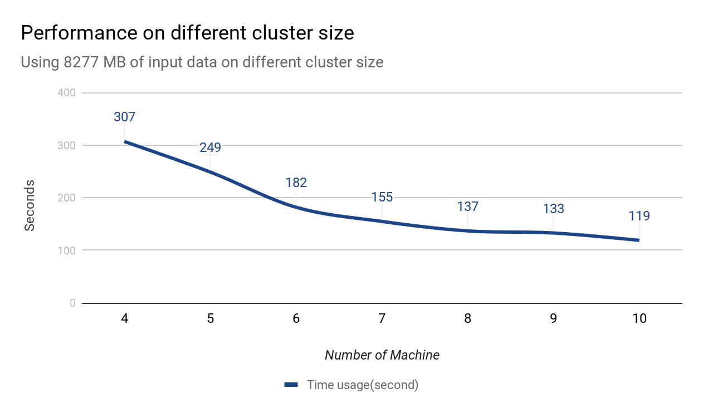
Evaluation result. Cluster size
Improvement is better when cluster size are small.
The performance improves less on bigger cluster size
133->119 (14) from 9->10
307->249 (58) from 4->5

Slide 14
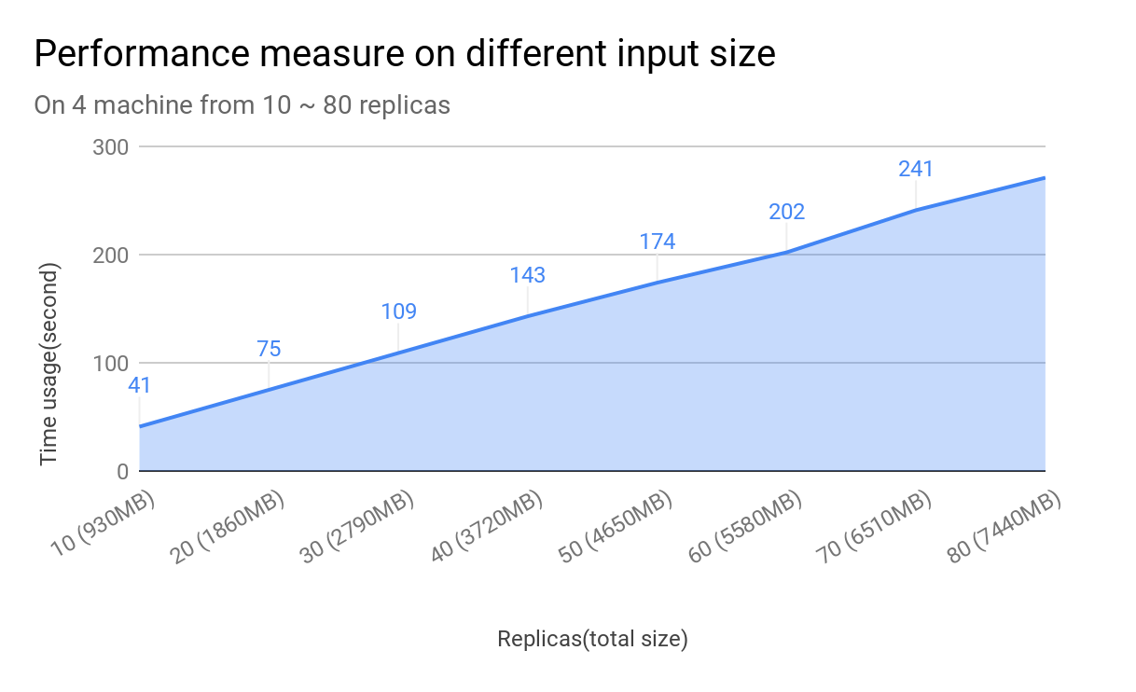
Evaluation result. Change File Size
With the same cluster size. Performance on different file size is more predictable.

Slide 15
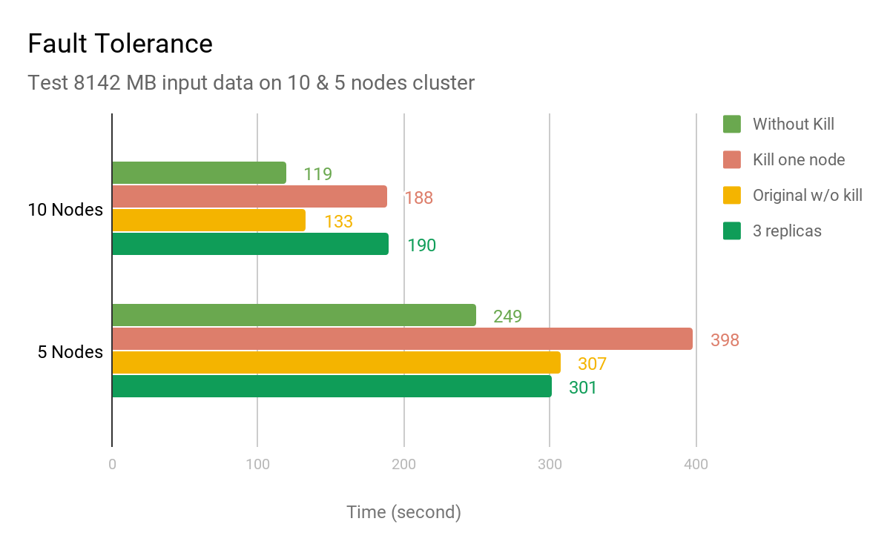
Evaluation result. Fault Tolerance
Time consumes more than starting the number of node after killing one node.
In 5->4 kill test container number changes from 91 to 96

Slide 16
Result
1.How many professional programer graduate from computer science background. ( CSBG/noneCSBG ratio).
We calculate from the original dataset, the professional programmers who are CS related majors are about 70.8% of the total professional programmers.

Slide 17

2. The most IDE used by developers.
Visual Studio is frequently used by most users in this survey.

Slide 18
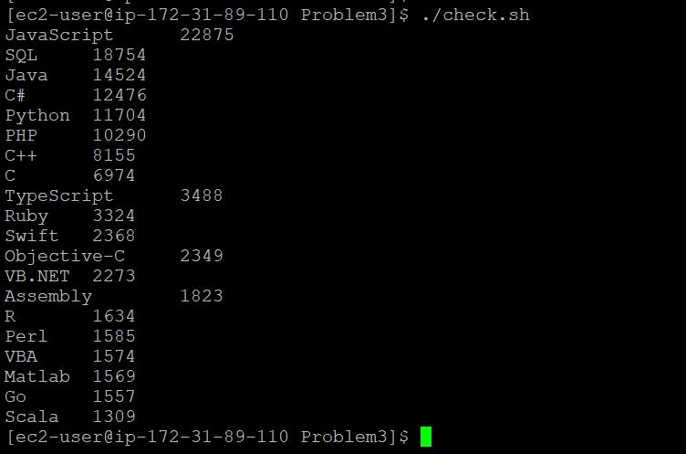
3. The ranking of used programing language.

Slide 19
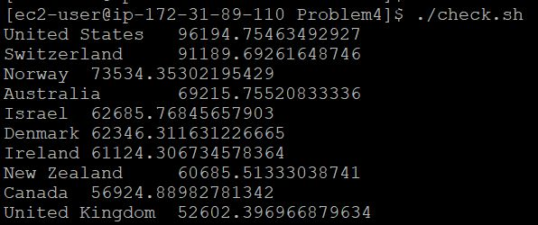
4. Average developers salary in different country. (In USD, annually)
We can see that United States has the highest average developers salary among all countries. For readability, we only show top 10 ranked countries.

Slide 20
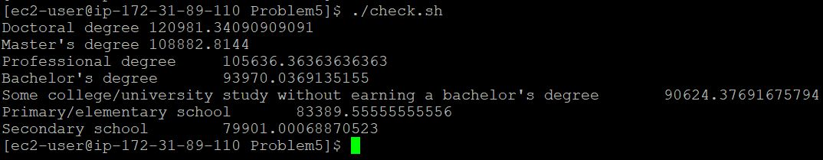
5. Average salary in different educating level in USA. (In USD, annually)
In general, higher the degree, higher the average salary of professional developers in USA.

Slide 21
Conclusion
Our model shows that using same size of input data. The size of the cluster does improve the performance, however the ratio of improvement gradually grows smaller at larger cluster size.
Compare to same machine size with variable file size. Our graph show the time needed for calculation has a linear growth with file size.
Our fault tolerance shows that on failure of one node. The lost work turns into extra work for other node to complete.
From our result, currently 30% of professional programmer does not come from CS background. So for not CS background people, it is worth to give it a try to work as a programmer!
As for working country. Consider only salary, USA has a better avg payroll compare to other country.
The most used IDE includes Visual Studio, a powerful IDE, but also notepad++, a very lightweight text editor. So as a programmer there is no really a best editor for coding. But there is a most suitable editor for your work.

